Slide 1


Full-stack application performance monitoring & observability solution for DevOps, ITOps, and SREs.

Slide 2
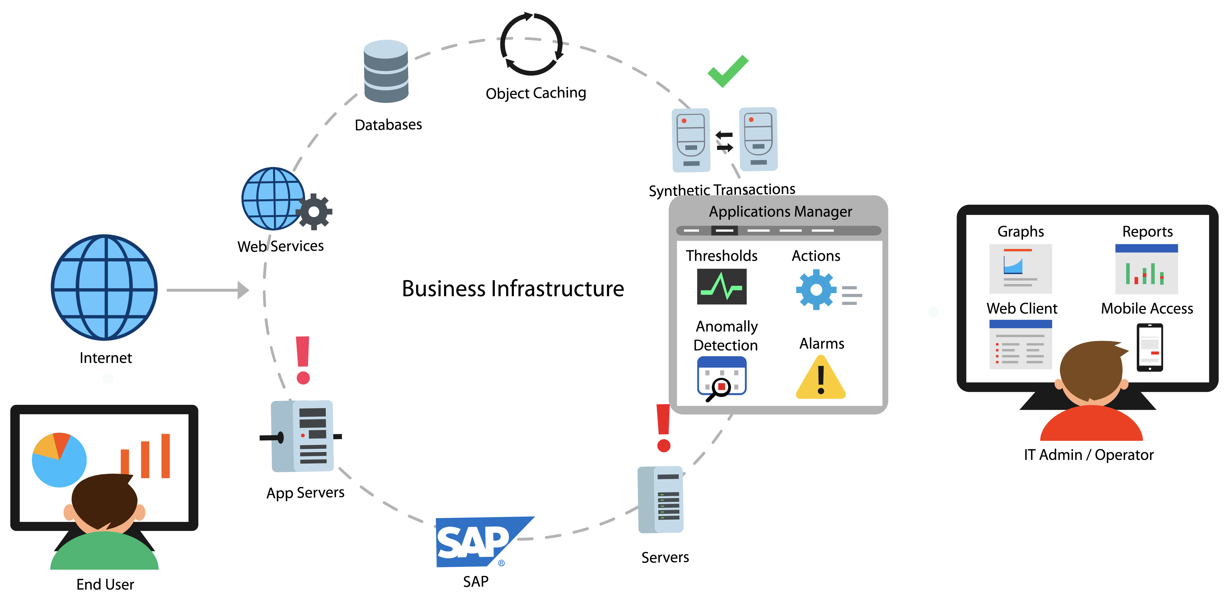
Applications Manager
Applications + infrastructure + end user experience monitoring - all from a single console
Notes:
Agentless, Editions, Supported database backend.

Slide 3
Who uses Applications Manager
IT Operations
DevOps Engineers
Site Reliability Engineers (SREs)
Database administrators (DBAs)
Production Support
CloudOps
Architects
Anyone who is responsible for application performance
Notes:
It is a minute after midnight and the site goes live. Soon after, users complain of several problems. The site is not reachable due to increased traffic. Even if the site is reachable for some people, the landing page appears to be slow. Customers who click on Mobiles and Tablets category leads to HTTP 500 internal server error. Some pages lead to a HTTP 502 bad gateway error. Whatever happened to the Electronics page!! This was nothing short of a disaster..

Slide 4
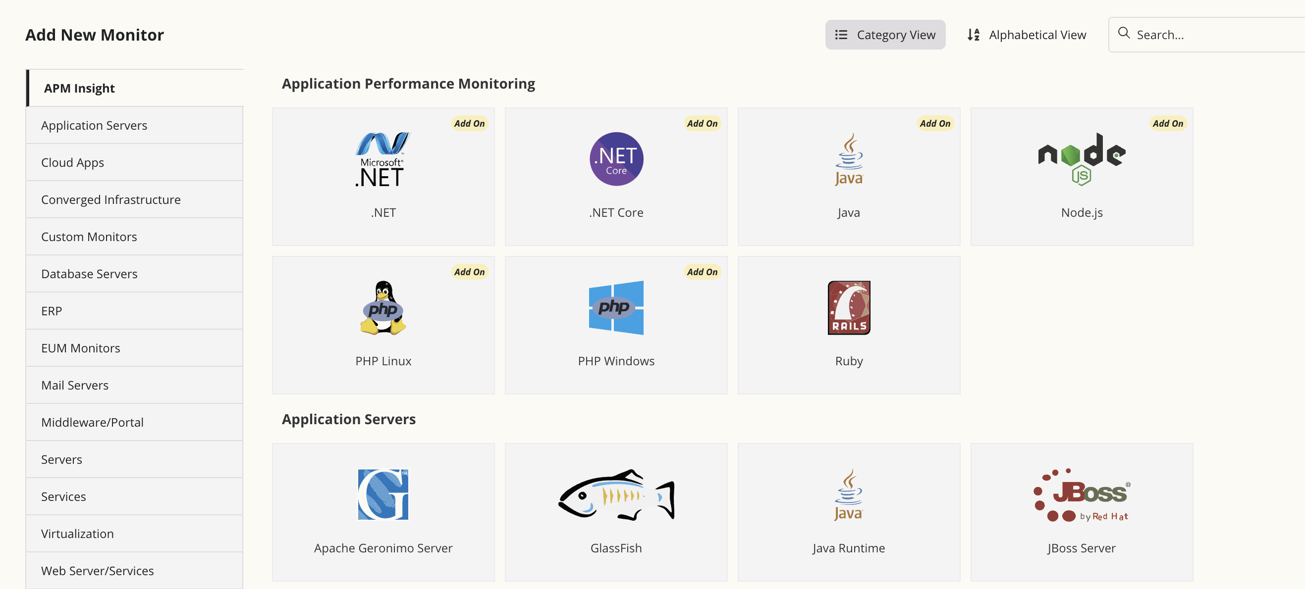
Applications Manager supports a diverse business infrastructure
Notes:
Agentless, Editions, Supported database backend.

Slide 5


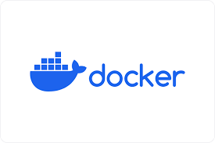


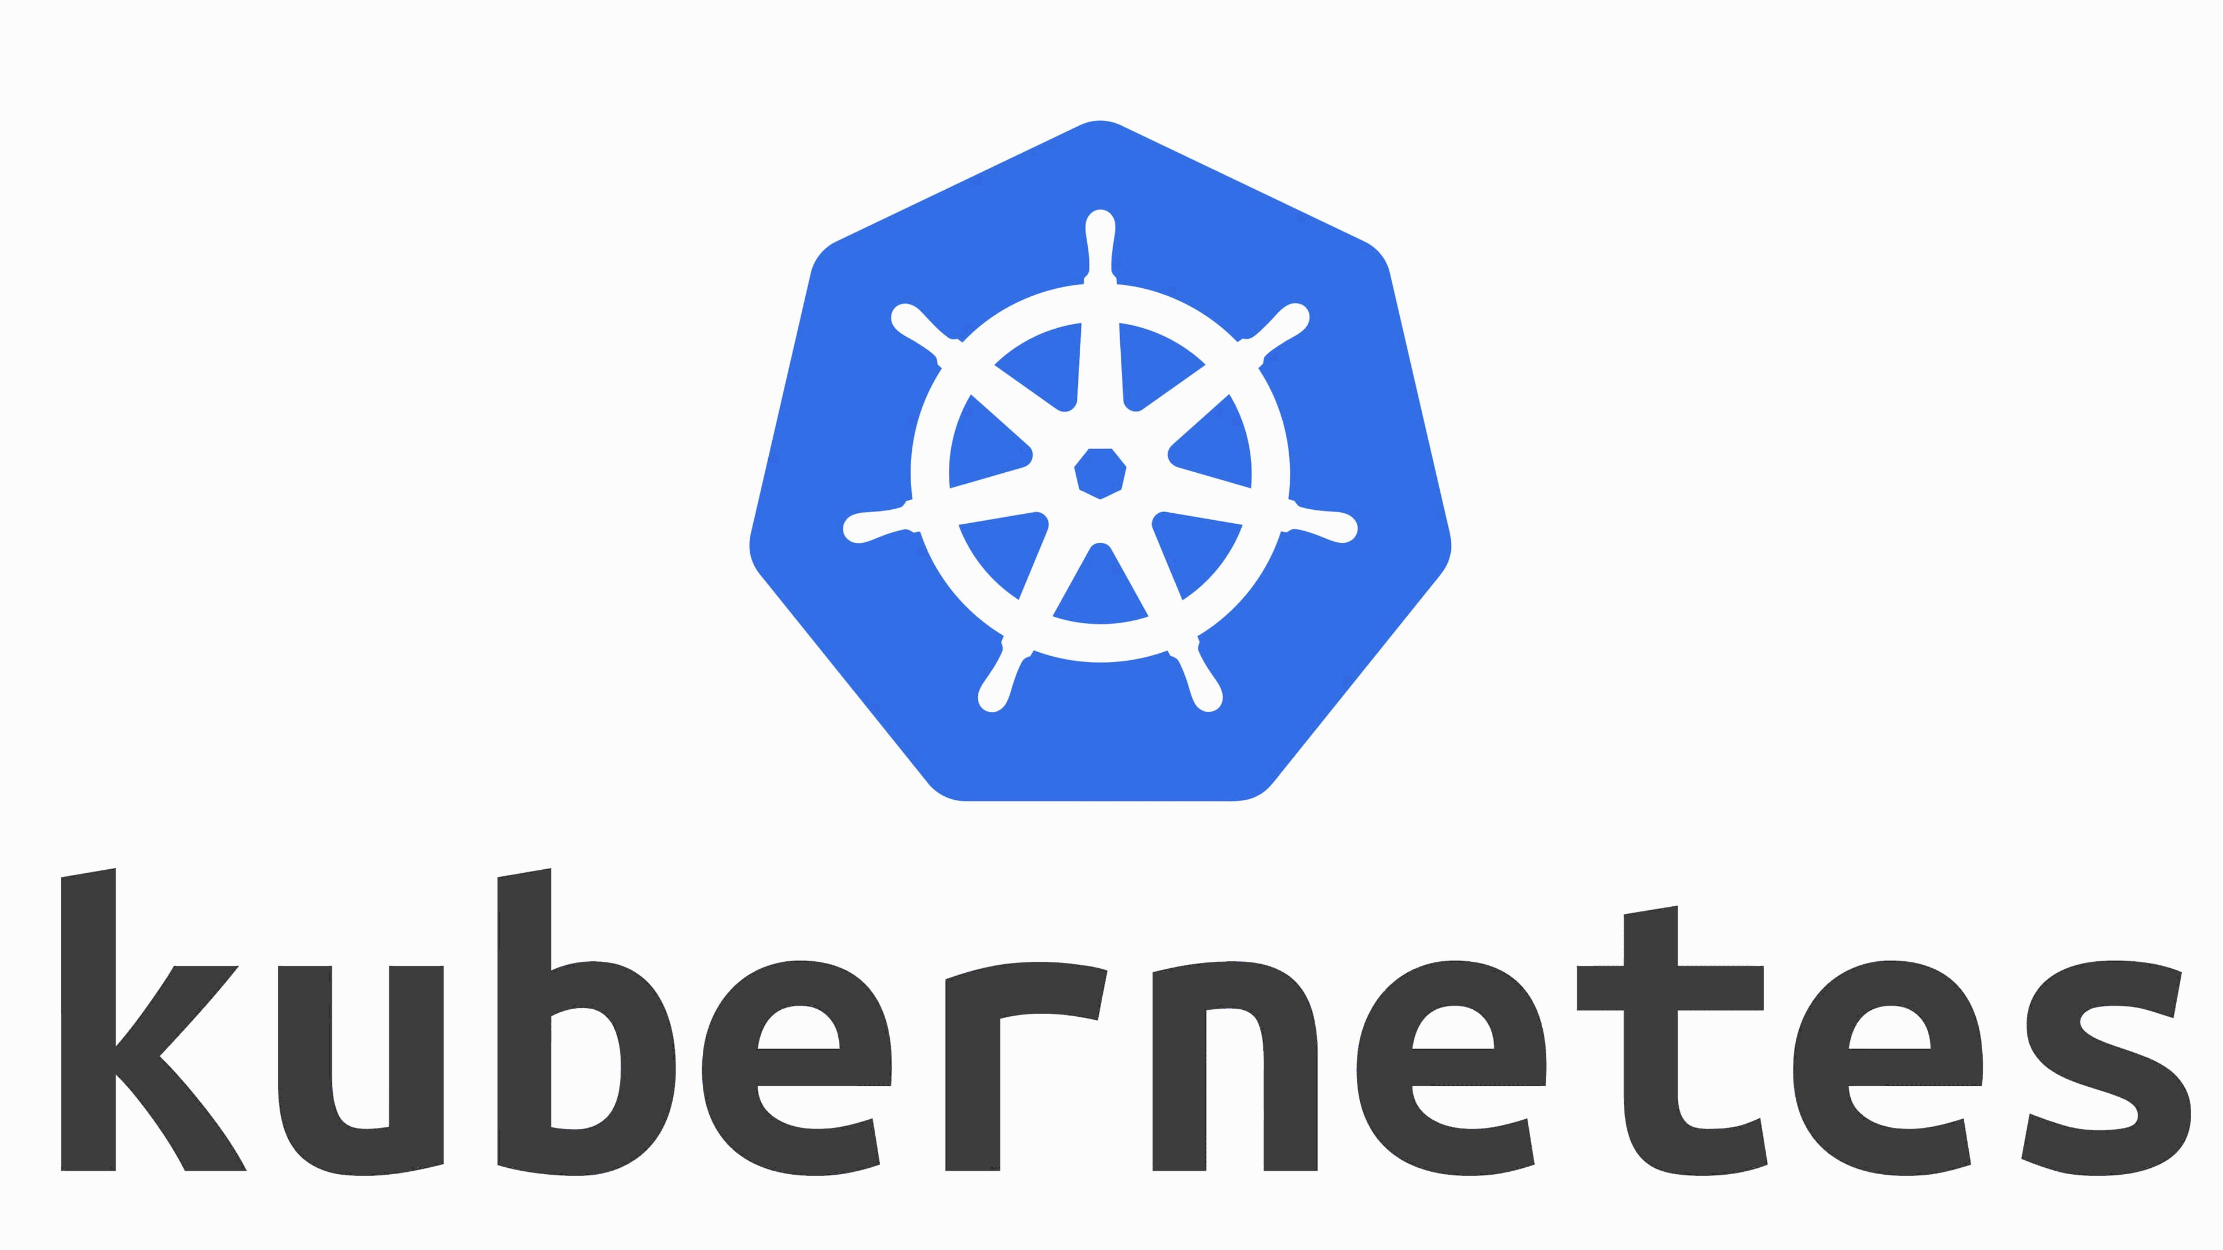


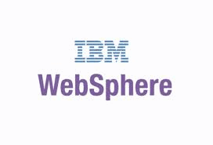



Support for traditional and modern applications
GUI
Notes:
Agentless, Editions, Supported database backend.

Slide 6








Application Performance
Monitoring
Find and fix performance issues across your entire application stack
Notes:
GroupsRule EngineCommon configuration

Slide 7
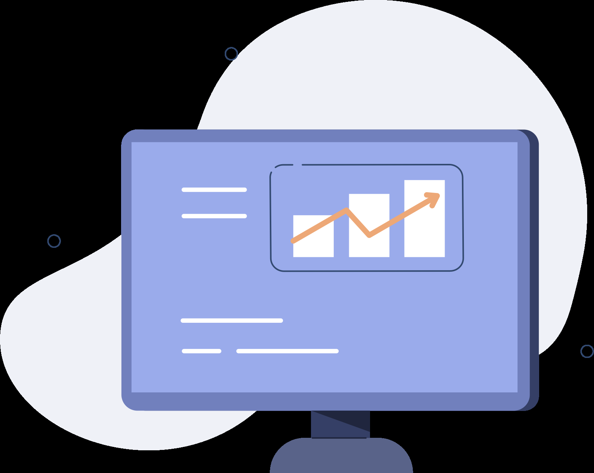

Deep APM with byte-code instrumentation
Application server
HTTP/HTTP(S)
APM agent
Byte code instrumentation
Applications Manager server
Data sent
Response time
Slow DB queries
Throughput
Apdex scores, etc.
Application
Notes:
The APM Insight is an agent-based monitoring tool. The remote agent needs to be deployed in the Machine where the Application Server is running. This agent performs the task of data collection; acquisition and transmission. The agent residing in the Application Server uses byte code instrumentation method to collect the data from the application and sends it to the Applications Manager at a fixed time intervals.

Slide 8
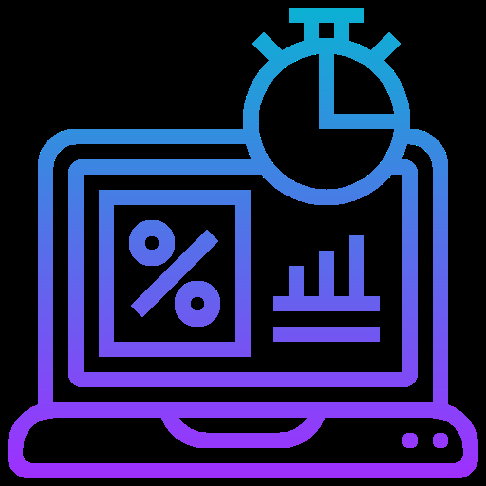





Transactions
Traces
Get complete insight into
Database Calls
Exceptions
Exceptions

Slide 9
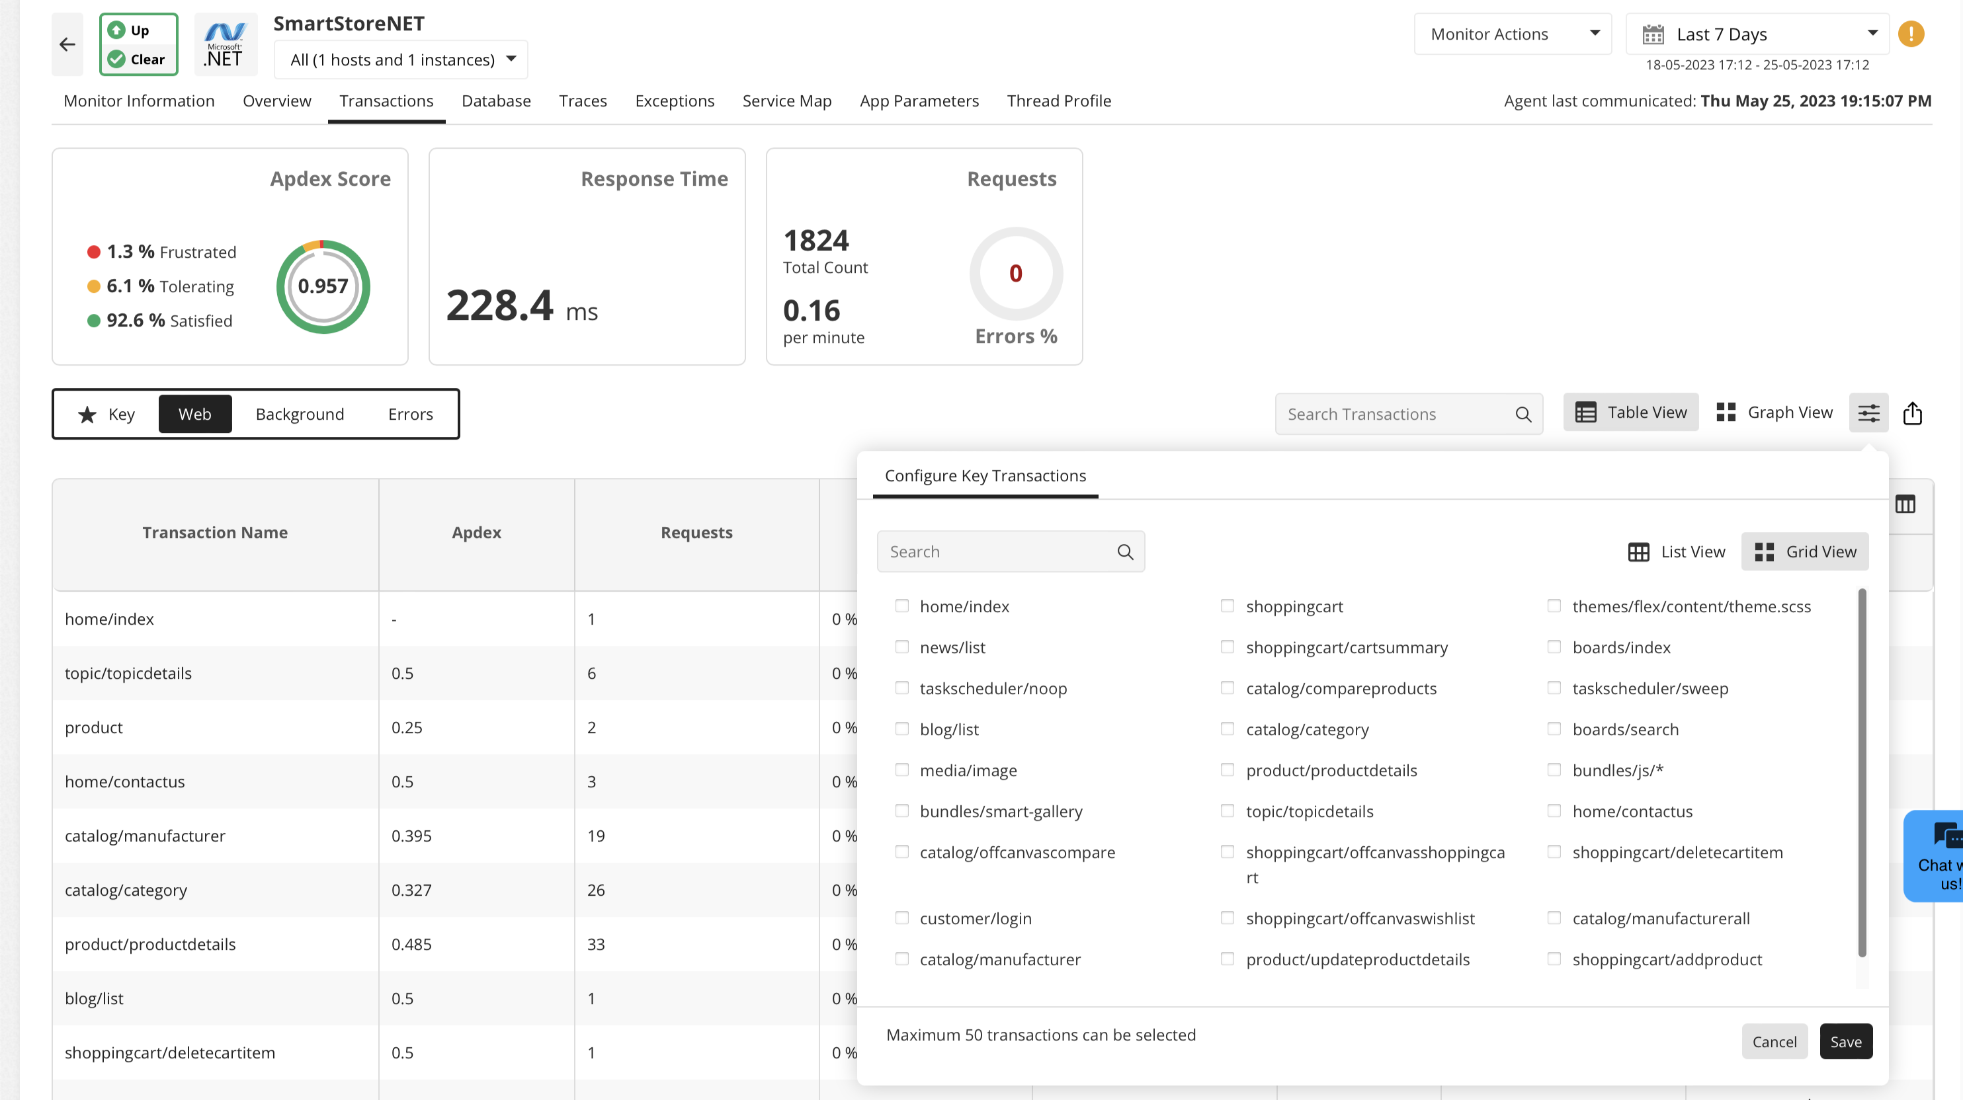
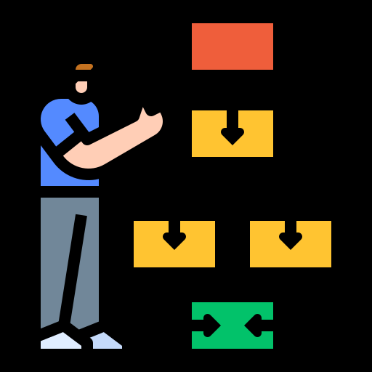
Refine Business Transactions
Identify the key business operations in your application and measure their performance.
Understand the customer experience.
Notes:
So by now you would be more interested on configuring the key business transaction to monitor the entire performance of the Application effectively. In this slide we shall see on configuring the key Transactions of your business operation. There could be an high-volume of activities made in the Application. All the transactions would be captured, among which you can select the key-transactions that you want to monitor in it and set threshold based on the response time of the transaction.

Slide 10
Refine business transactions
Identify the key business operations in your application and measure their performance.
Understand the customer experience.

Slide 11








Kubernetes Cluster
Collects data
SQL
Identify issue
Issue fixed
Leverage
distributed
tracing
Track transactions made from one application to another.
Also called as cross-application tracing.
Useful when application is built on microservices architecture.
Notes:
So by now you would be more interested on configuring the key business transaction to monitor the entire performance of the Application effectively. In this slide we shall see on configuring the key Transactions of your business operation. There could be an high-volume of activities made in the Application. All the transactions would be captured, among which you can select the key-transactions that you want to monitor in it and set threshold based on the response time of the transaction.

Slide 12
Leverage distributed tracing
Track transactions made from one application to another.
Also called as cross-application tracing.
Useful when application is built on microservice architecture.
Collects data
Kubernetes Cluster
Database
Identifies
the issue
Issue fixed

Slide 13
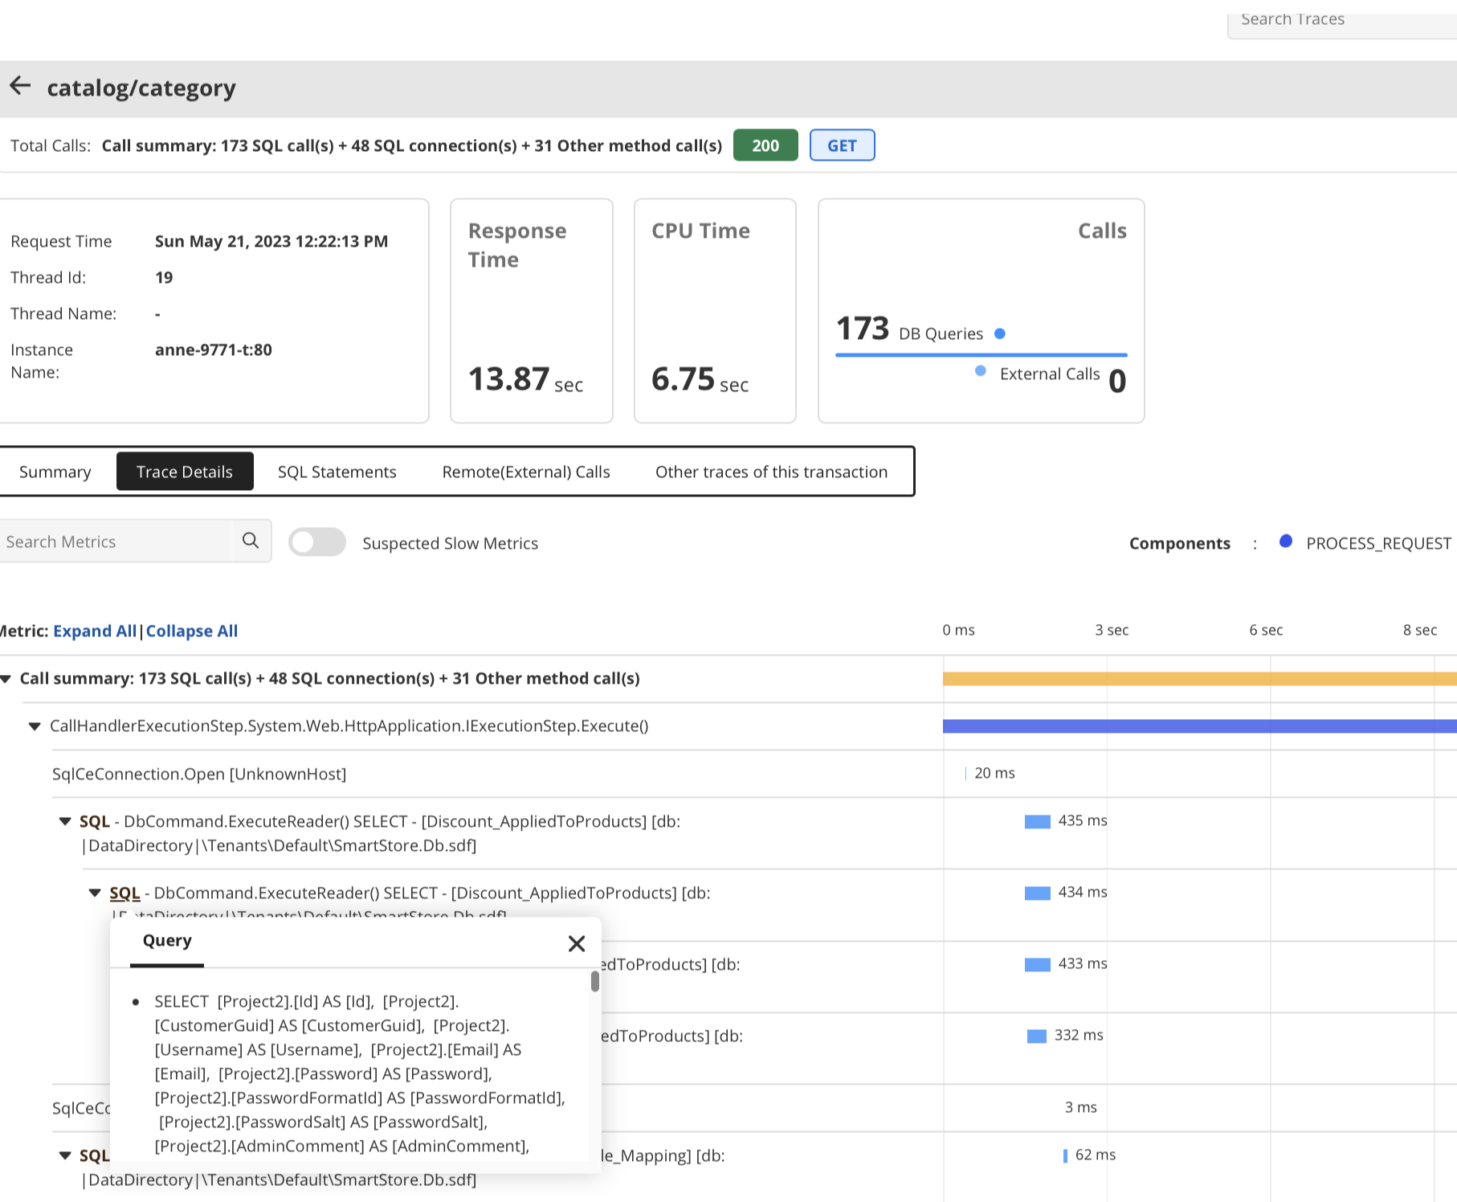
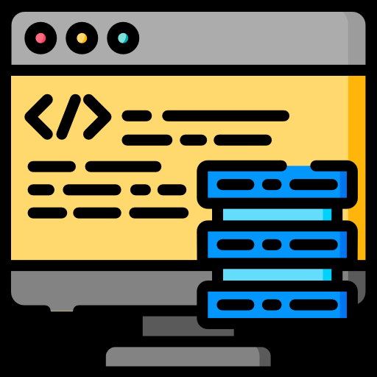
Eliminate
issues with
problematic
code
Stack trace:
When the Java application throws an exception during the execution of program, a stack trace gets logged with it.
Helps engineers figure out where the problem lies and resolve issues faster.
Notes:
So by now you would be more interested on configuring the key business transaction to monitor the entire performance of the Application effectively. In this slide we shall see on configuring the key Transactions of your business operation. There could be an high-volume of activities made in the Application. All the transactions would be captured, among which you can select the key-transactions that you want to monitor in it and set threshold based on the response time of the transaction.

Slide 14
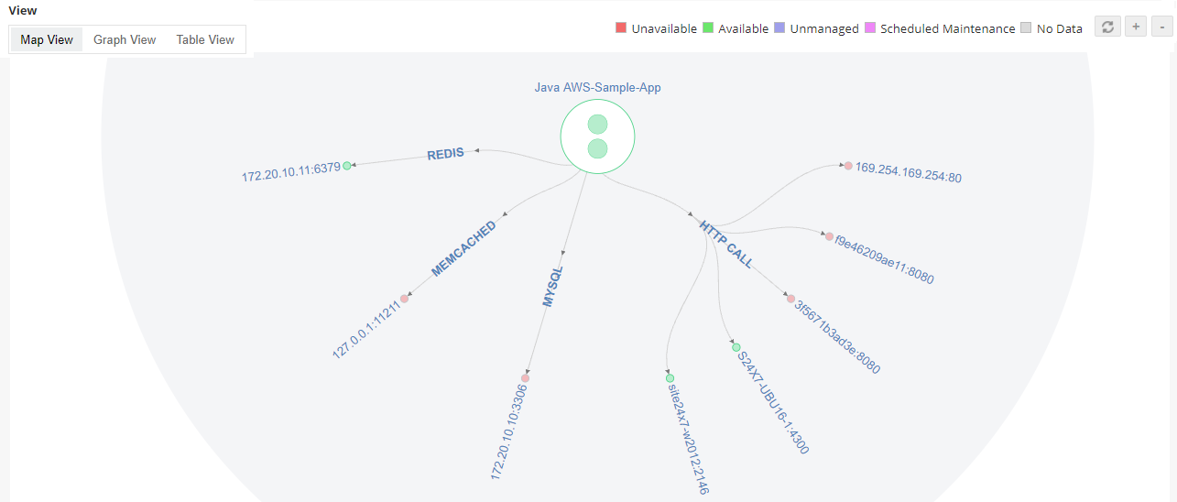
Automated service maps
.
Notes:
Map View: Provides the way of analyzing the topological view of the application and along with its instances are represented in the central node.Now let's look at how all these can be achieved in the APMInsight Monitor and discuss on generating the Reports and Configure Alarms for the performance metrics

Slide 15

Infrastructure monitoring
Monitor the IT infrastructure that powers your applications
Notes:
GroupsRule EngineCommon configuration

Slide 16

Out-of-the-box support for 150+ applications
Databases
Servers
Application servers, web servers, services
VMs, converged infrastructure
Containers
Cloud apps
ERP
Middleware

Slide 17
More on infrastructure monitoring
Monitor IT infrastructure metrics alongside APM and distributed traces in a single, integrated platform - without having to switch between multiple tools.
Supports monitoring of both on premise and cloud infrastructure.
Agentless monitoring tool.
Supports both modern apps such as Kubernetes and legacy servers such as AS/400.
Vendor agnostic: Supports popular commercial vendors such as Microsoft, Oracle, SAP, IBM, AWS, and VMware as well as open source such as Apache and Red Hat.
Notes:
It is a minute after midnight and the site goes live. Soon after, users complain of several problems. The site is not reachable due to increased traffic. Even if the site is reachable for some people, the landing page appears to be slow. Customers who click on Mobiles and Tablets category leads to HTTP 500 internal server error. Some pages lead to a HTTP 502 bad gateway error. Whatever happened to the Electronics page!! This was nothing short of a disaster..

Slide 18
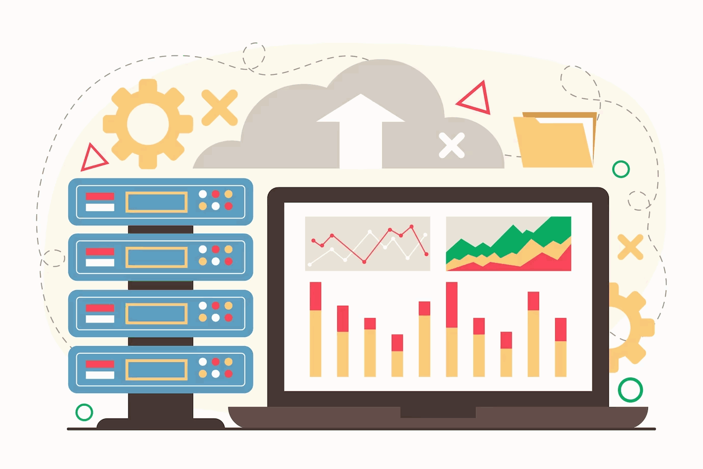
Hybrid cloud monitoring
Support for major cloud vendors like AWS, Azure, Google cloud, and Oracle Cloud.
Migrate your workloads to the cloud with ease while keeping track of the performance of critical applications.
Stay up to date on your cloud spending with our AWS billing feature.
Notes:
It is a minute after midnight and the site goes live. Soon after, users complain of several problems. The site is not reachable due to increased traffic. Even if the site is reachable for some people, the landing page appears to be slow. Customers who click on Mobiles and Tablets category leads to HTTP 500 internal server error. Some pages lead to a HTTP 502 bad gateway error. Whatever happened to the Electronics page!! This was nothing short of a disaster..

Slide 19
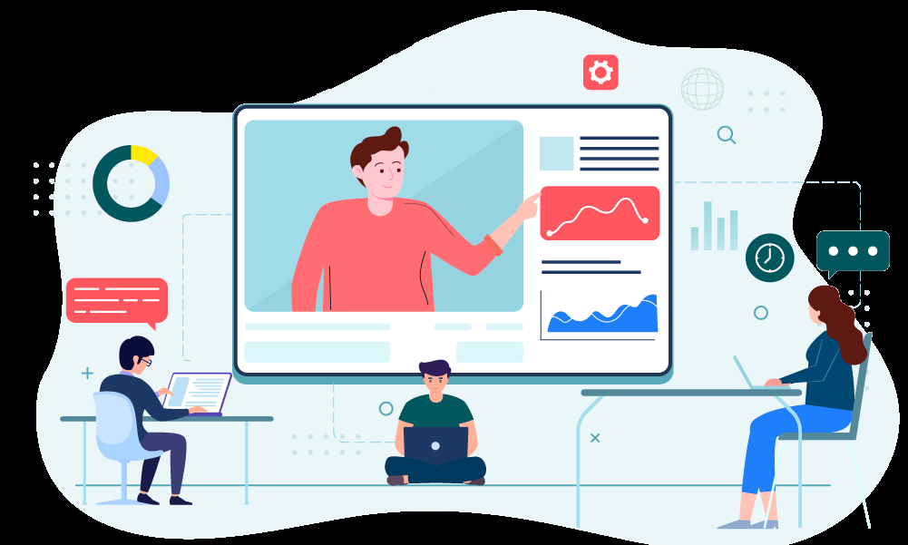
Digital Experience Monitoring
Deliver flawless end user experiences
Notes:
GroupsRule EngineCommon configuration

Slide 20
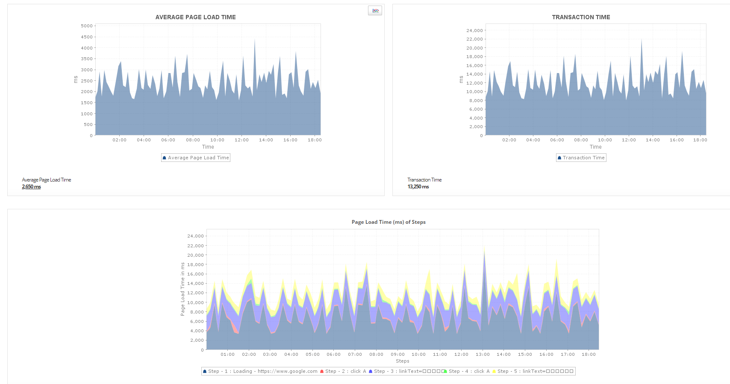
Real browser monitoring with Applications Manager
Simulate business-critical processes via selenium based scripting of tests.
Run checks from real browsers such as Chrome or Firefox.
Take screenshots for reference when there are errors.
Test from multiple locations - enterprise branch offices or actual customer locations.

Slide 21
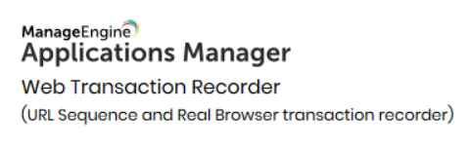




Real browser monitoring with Applications Manager
Branch office -1
Branch office -2
Branch Office -3
EUM Agent -1
EUM Agent -2
EUM Agent -3

Slide 22

Real User Monitoring (RUM)
Real User Monitoring is a type of End-User Experience monitoring that captures and analyzes each transaction by users of a website or application.
Determine actual service quality and record all user interactions in a website.

Slide 23
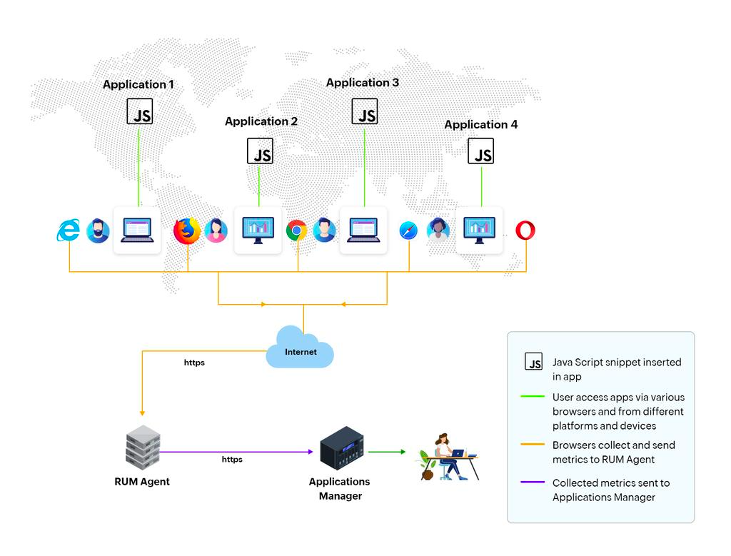
How does RUM work?
Download and install RUM agent.
Generate a small JavaScript snippet from the Applications Manager console.
Insert it in the header or footer of the HTML code of the webpage you want to monitor.
If you want to monitor a web application, insert the code in a common/index page of the web application that needs to be monitored.

Slide 24


Other features
Notes:
GroupsRule EngineCommon configuration

Slide 25
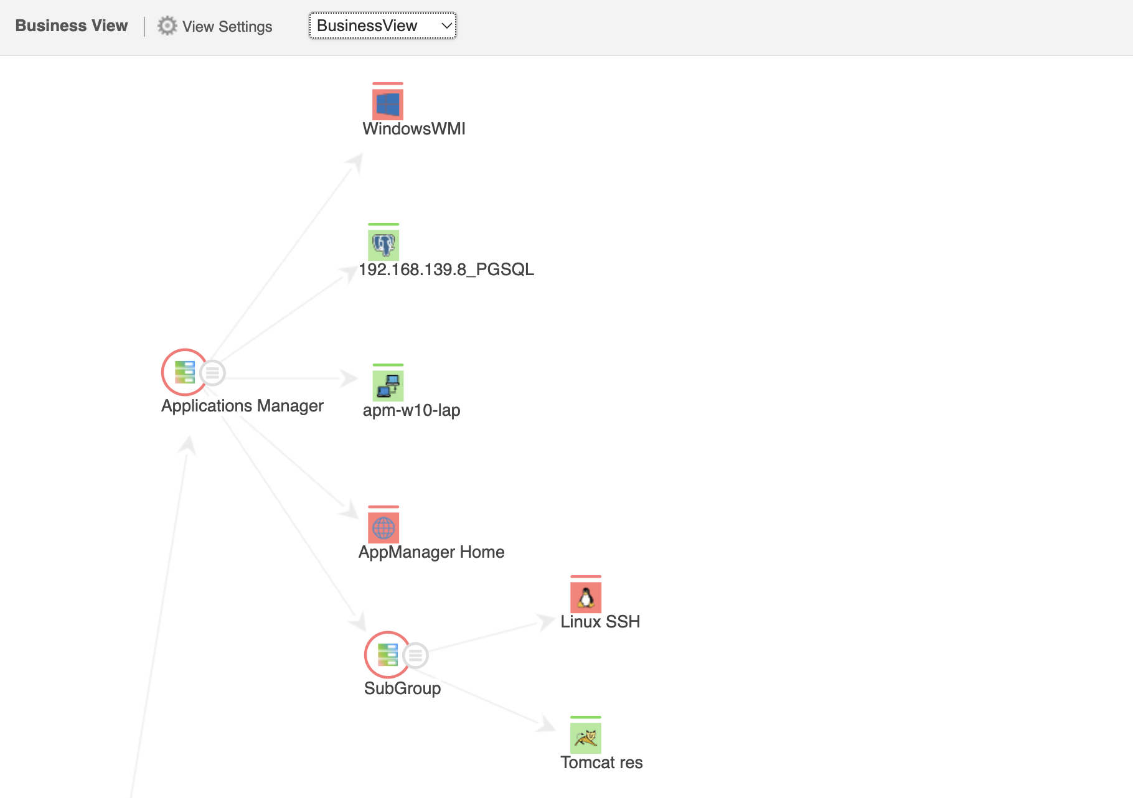
Automatic Discovery and Dependency Mapping

Slide 26
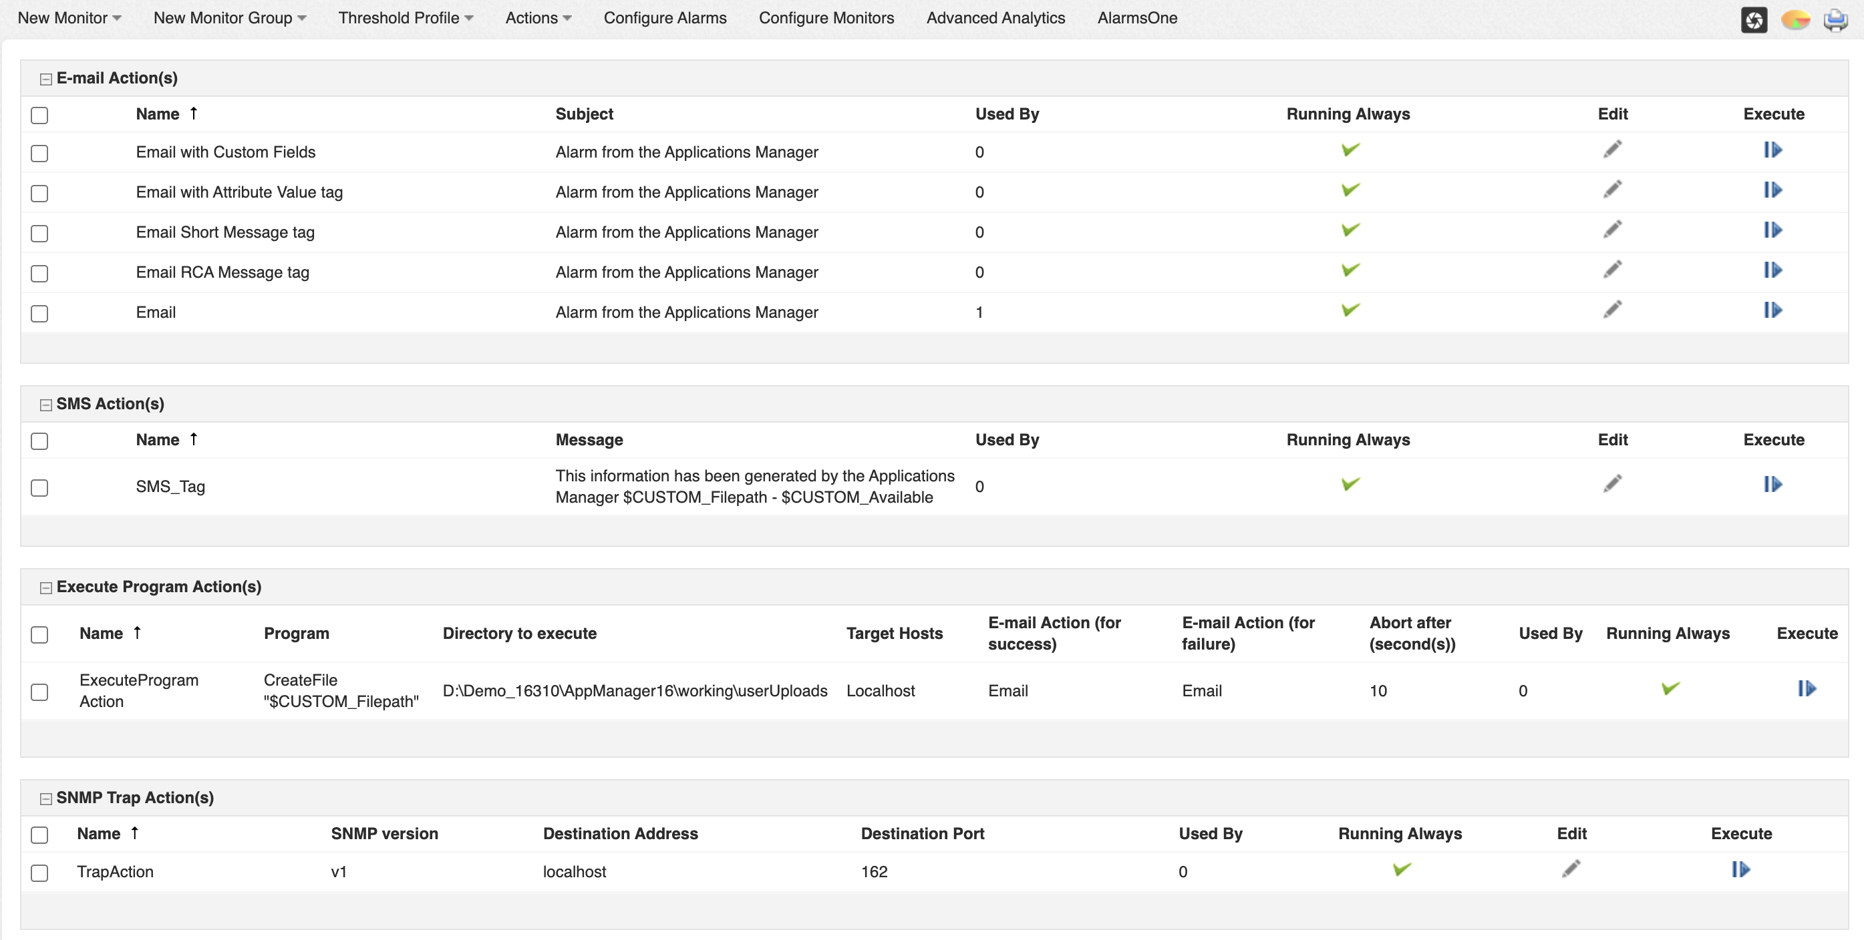
Business Service Management

Slide 27
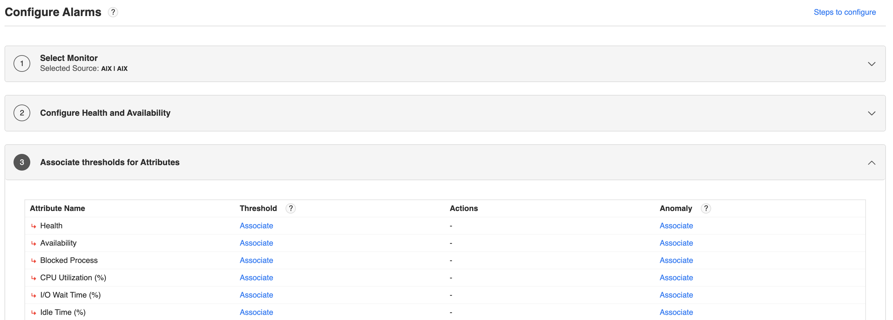
Real-time Notifications

Slide 28
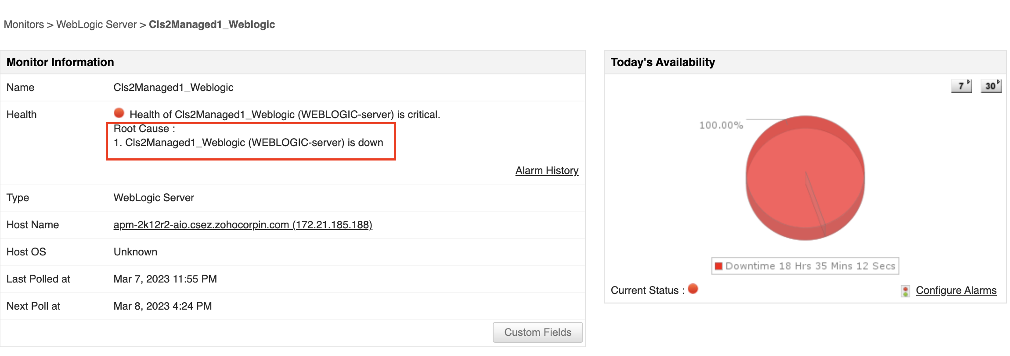
Root Cause Analysis

Slide 29
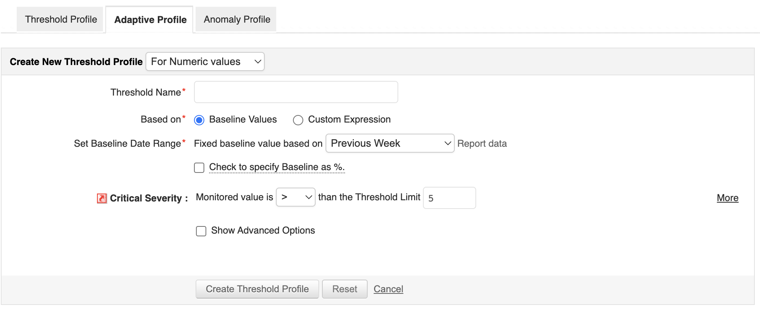
Adaptive thresholds

Slide 30
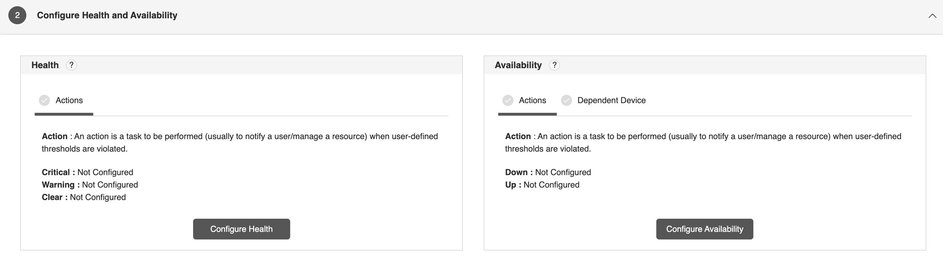
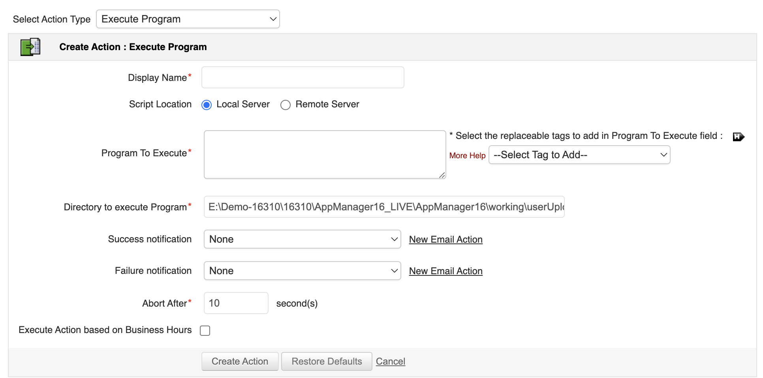
Automate corrective actions

Slide 31
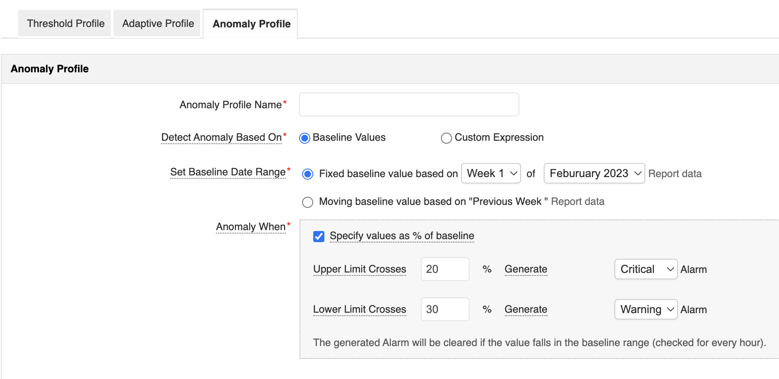
AI-based anomaly detection

Slide 32
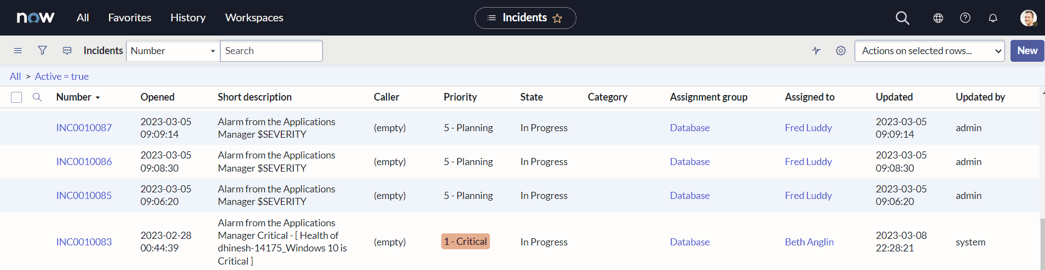
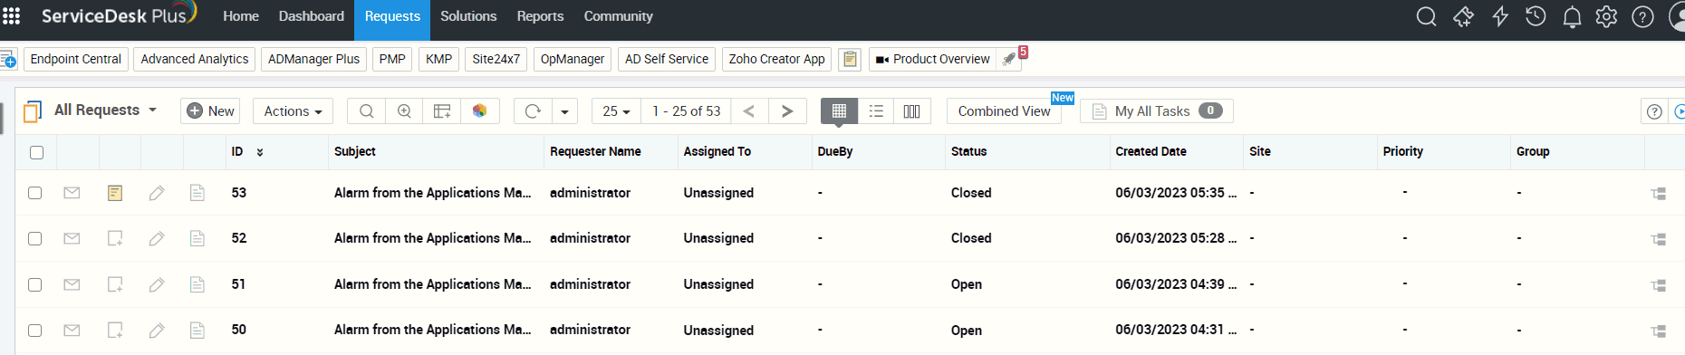
Log a ticket in ServiceNow/ServiceDesk Plus

Slide 33
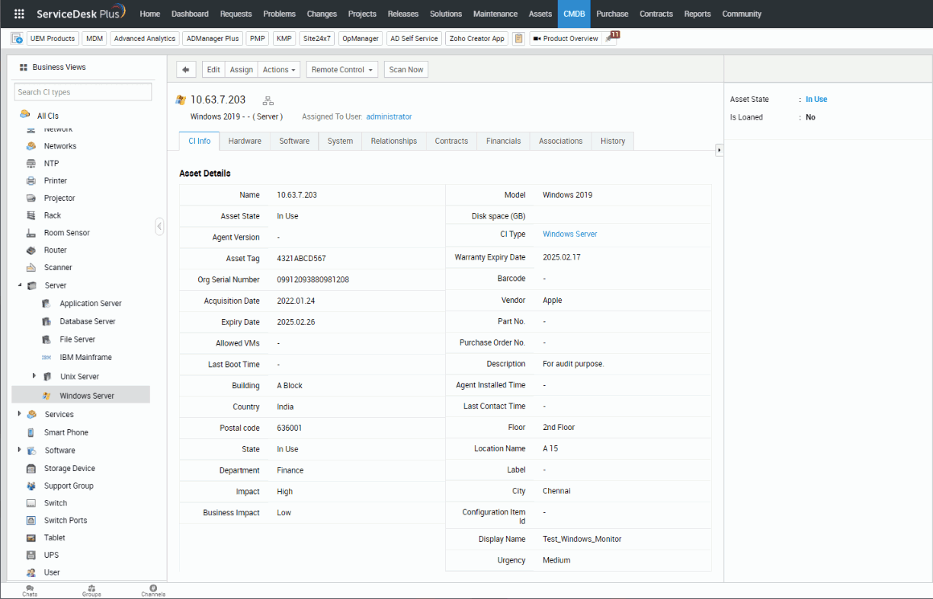
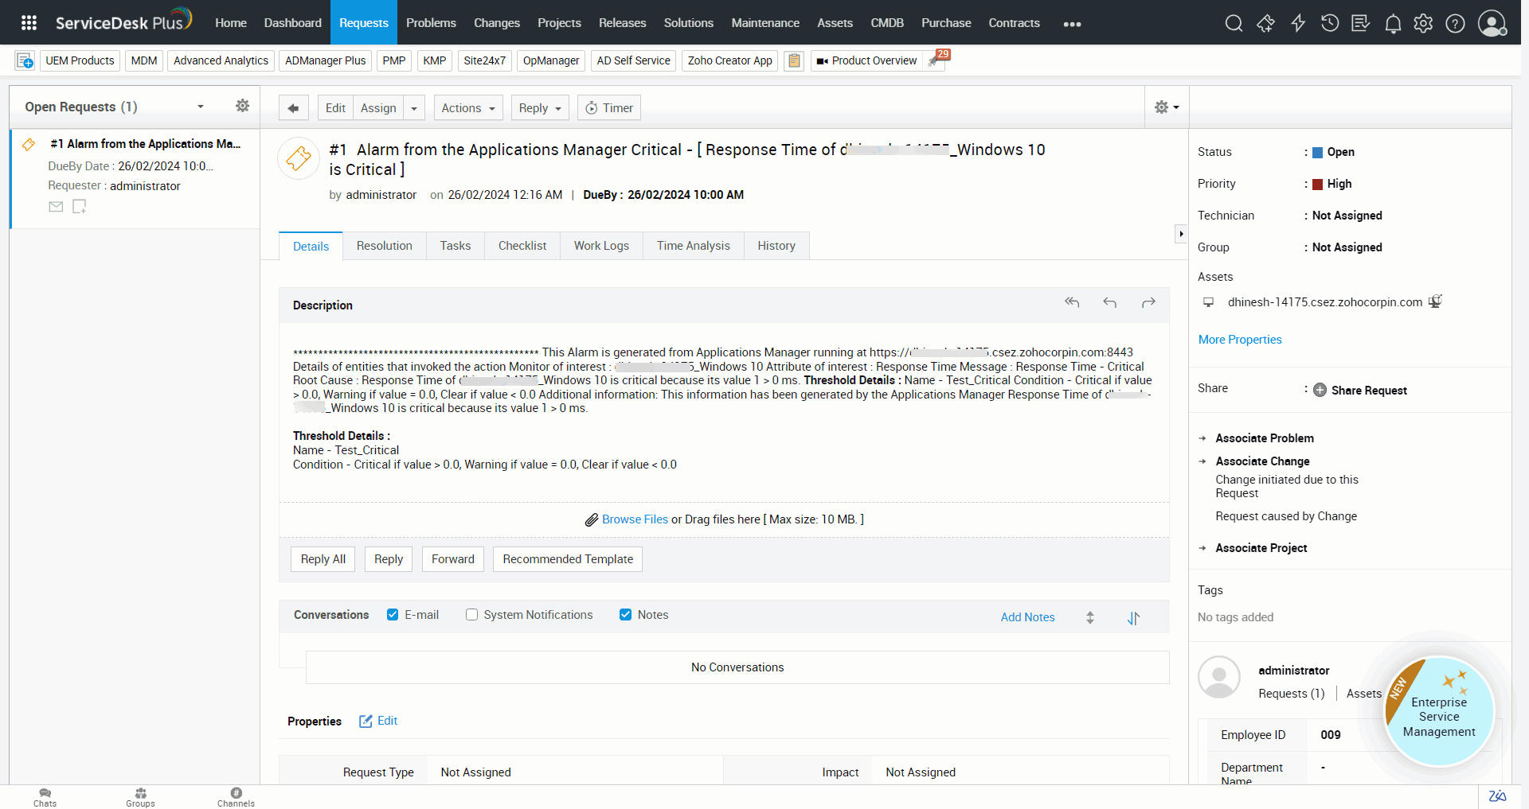
Log a ticket in ServiceNow/ServiceDesk Plus

Slide 34
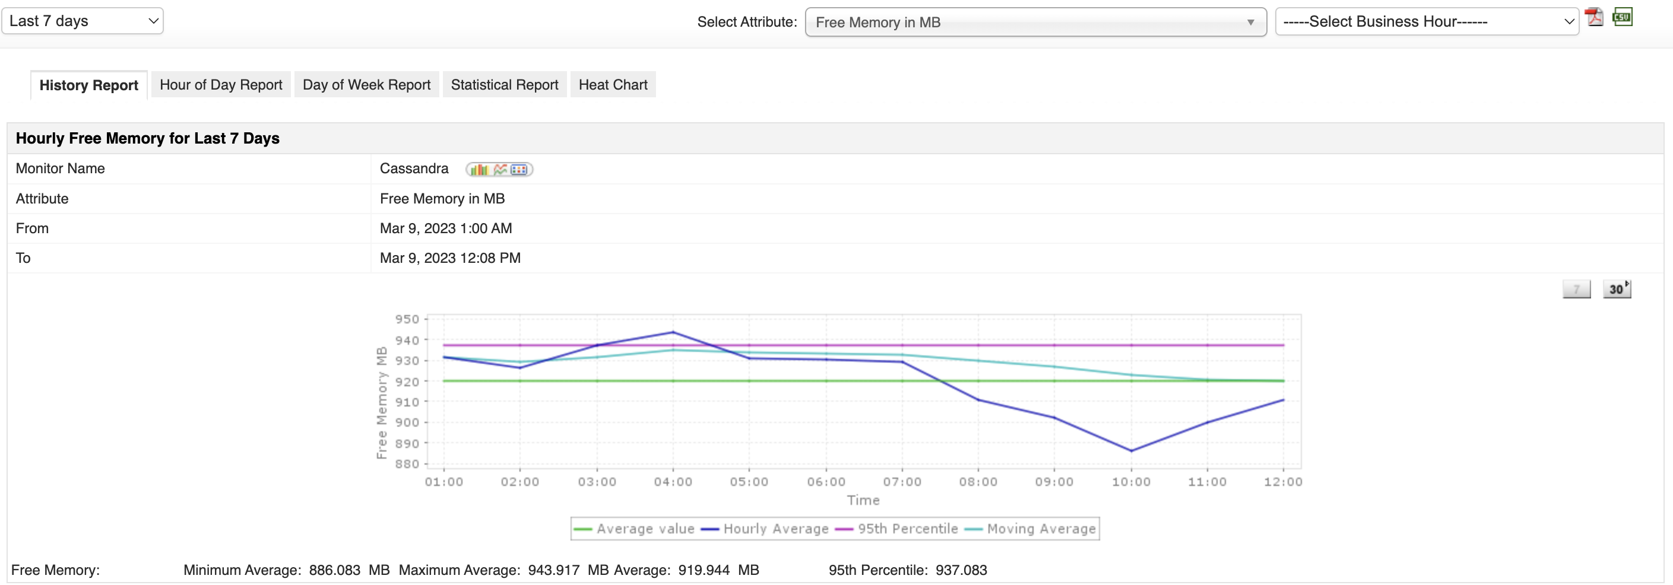
Trend Analysis Reports

Slide 35
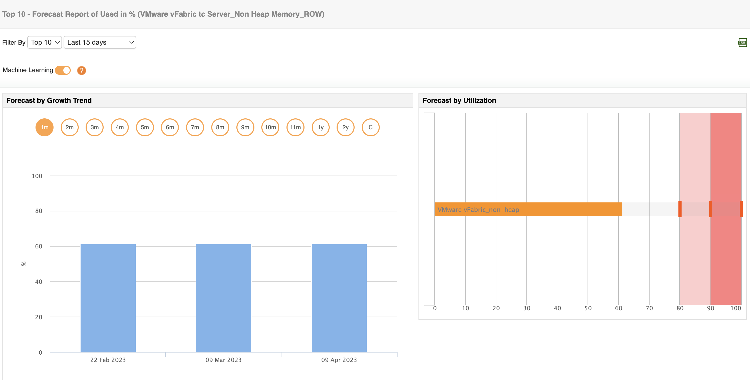
Forecast Reports

Slide 36
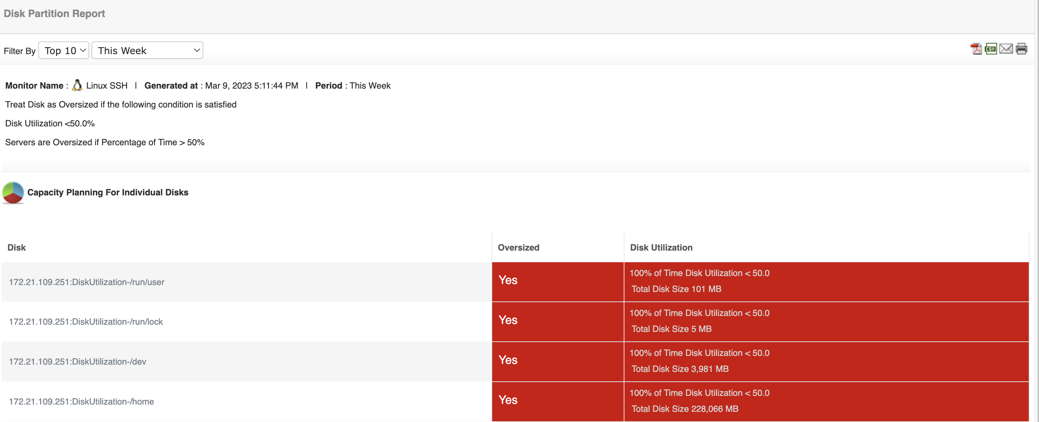
Capacity Planning Reports

Slide 37
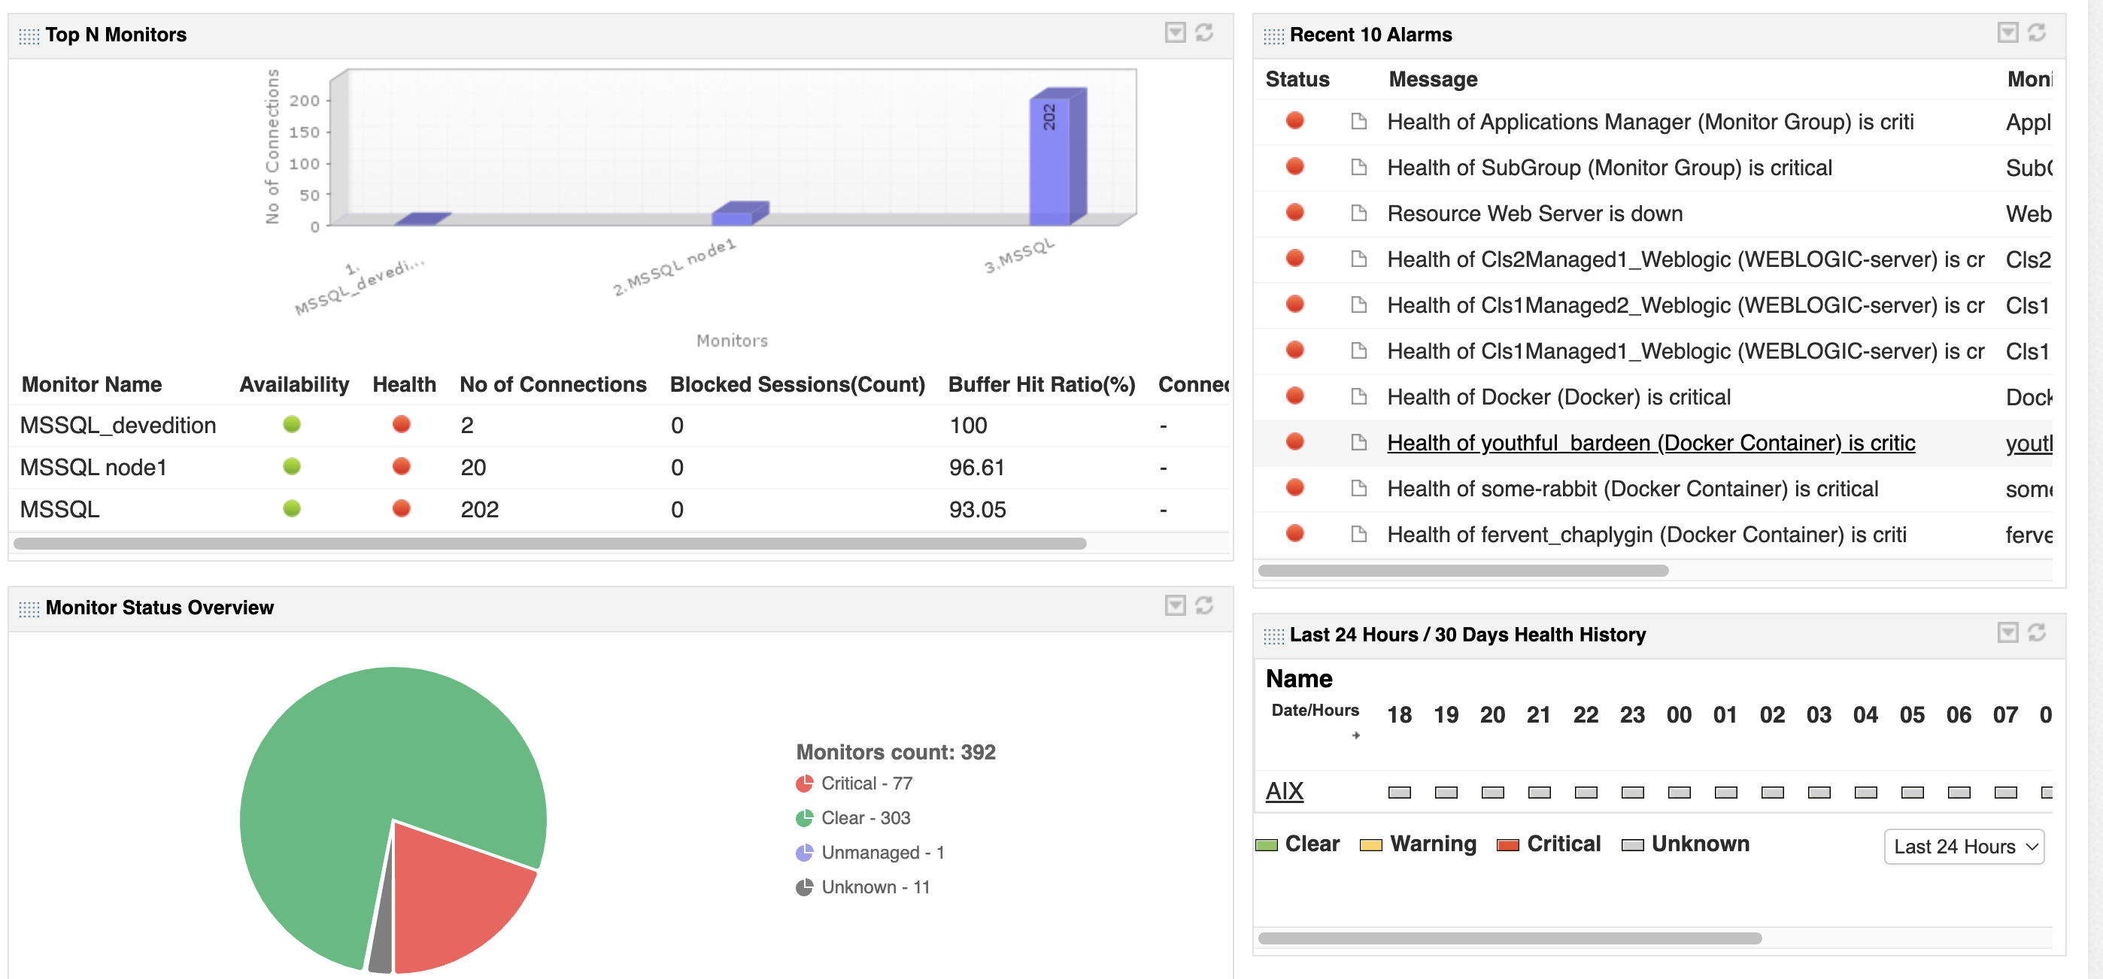
Customizable Dashboards

Slide 38
Other highlights
No need to integrate multiple products or community generated scripts
Easy to use and deploy.
Native mobile apps - iOS and Android
Provides REST APIs to integrate with portals
Flexible deployment options - on premise, AWS & Azure marketplace
Notes:
It is a minute after midnight and the site goes live. Soon after, users complain of several problems. The site is not reachable due to increased traffic. Even if the site is reachable for some people, the landing page appears to be slow. Customers who click on Mobiles and Tablets category leads to HTTP 500 internal server error. Some pages lead to a HTTP 502 bad gateway error. Whatever happened to the Electronics page!! This was nothing short of a disaster..

Slide 39






Why Applications Manager
Quick time-to-value
High scalability
Enterprise-grade security
Low TCO
Friendly support
Transparent pricing & licensing
Low TCO

Slide 40
Available in 2 editions
Professional
Ideal for small to medium businesses
Monitor up to 500 applications based on load
Enterprise
Ideal for medium to large enterprises
Distributed monitoring architecture - scales up to 10,000 applications or more based on load
Notes:
It is a minute after midnight and the site goes live. Soon after, users complain of several problems. The site is not reachable due to increased traffic. Even if the site is reachable for some people, the landing page appears to be slow. Customers who click on Mobiles and Tablets category leads to HTTP 500 internal server error. Some pages lead to a HTTP 502 bad gateway error. Whatever happened to the Electronics page!! This was nothing short of a disaster..

Slide 41

What our customers say
"Applications Manager's automated approach has helped us continuously discover our applications, gain instant insights, and achieve rapid time-to-value. We couldn't be more happier about our choice!"
- Alejandro Delgado, IT monitoring manager, Techedge

Slide 42

What our customers say
"With Applications Manager, we are able to gain visibility across our entire IT stack and pinpoint issues effectively. This has reduced the number of customer complaints we receive significantly."
- Meshal Ahmed Alsaiari, IT operations specialist, GACA

Slide 43
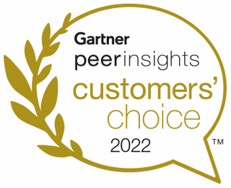



Recognized by Industry Analysts
Recognized in the 2023 Gartner Magic Quadrant for Application Performance Monitoring and Observability
Gartner Peer Insights Customers' Choice 2023 for Voice of Customer for Application Performance Monitoring and Observability
Software Reviews Champion 2023 for Application Performance Management - Enterprise
Recognized in 2023 GigaOm radar for Application Performance Management
Notes:
It is a minute after midnight and the site goes live. Soon after, users complain of several problems. The site is not reachable due to increased traffic. Even if the site is reachable for some people, the landing page appears to be slow. Customers who click on Mobiles and Tablets category leads to HTTP 500 internal server error. Some pages lead to a HTTP 502 bad gateway error. Whatever happened to the Electronics page!! This was nothing short of a disaster..

Slide 44










Trusted by 1000s of businesses worldwide

Slide 45
Thank you
eval-apm@manageengine.com

