Slide 1


Slide 2






ManageEngine
A division of Zoho Corporation, a bootstrapped, private, and profitable company
18+ years of
IT management solutions expertise
180,000+
customers
2,500+ employees
90+ products & free tools for IT management
190+
countries

Slide 3

The challenges
faced by customer support teams

Slide 4







Improper tracking of customer tickets
Absence of collaboration between agents
Increased communication gaps
Lack of insights into help desk operations
Suboptimal agent productivity
Violations of service-level agreements (SLAs)
Inaccurate time tracking and billing

Slide 5

The result
A suboptimal support experience for customers & agents alike, resulting in dissatisfied customers and loss of business.

Slide 6
SupportCenter Plus is web-based customer support software that enables organizations to effectively manage customer tickets, client accounts, and service contracts to facilitate a superior customer experience.
Some facts about SupportCenter Plus
Used across multiple industries such as hospitality, health care, government organizations, NGOs, computer hardware, and more.
SupportCenter Plus can handle up to 750 service reps, 50,000 contacts, and 1,000 requests per day.

Slide 7

Why
SupportCenter Plus?

Slide 8





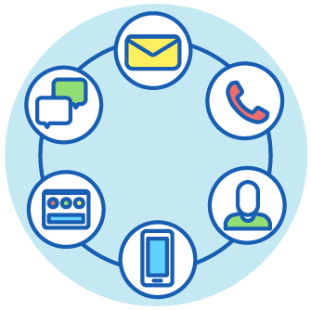
Implement best practices out of the box
A simple and easy-to-use interface
Highly customizable to suit business workflows
Comprehensive analytics capability
Integrations with popular third-party apps like Jira, Salesforce, and Twitter
Support for multiple support channels

Slide 9

The eight ways SupportCenter Plus
revolutionizes your
customer support experience

Slide 10
1
Establish & manage customer relationships with ease

Slide 11
2
Manage customer interactions in one place

Slide 12
3
Customize plan type, bill cycle, allowance, and usage for each customer with unique support plans

Slide 13
4
Boost productivity by reducing rework

Slide 14
5
‌Maintain accurate time entries & expenses

Slide 15
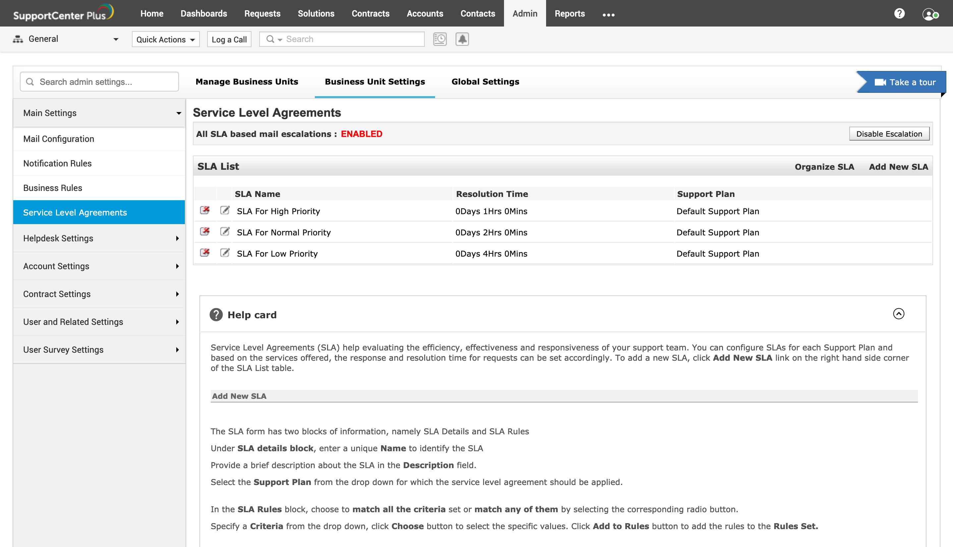
6
Stay compliant with service level agreements (SLAs)

Slide 16
7
Manage all your business units from a single place

Slide 17
8
Stay on top of all information and stats on your support operations

Slide 18

Top customer support capabilities
Multi-channel support
Request management
Knowledge management
SLA management
Account and contact management
Time tracking and billing
Request life cycle management
Self-service portal
Live chat
Reports, dashboards, and KPIs
Field service management
Deep integrations

Slide 19



Editions
Enterprise
Professional
Standard
Help desk management
Customer portal
Billing Contracts
Product catalog
Active Directory integration
Dashboards
Survey
API
Help desk management
Customer portal
Billing contracts
Product catalog
Active Directory
Request tracking
Knowledge base
SLA management
Help desk reports
Account & contact
integration
Dashboards
Survey
management
Tasks
The right package for a comprehensive customer support help desk
Full-fledged customer support kit with advanced features for customer support
The perfect starter kit for customer support.

Slide 20




Supported databases, browsers, & OSs
Windows Server 2012-2016
Windows 7/8/10
RHEL 8 and above
Ubuntu 14.0 and above
MSSQL 2017, 2016, 2014
MSSQL 2012, 2010, 2008
PostgreSQL
Internet Explorer: IE11, IE Edge
Firefox
Google Chrome
24x5 support via email, phone, forum, and live remote sessions for all our paid customers.

Slide 21


















Customers

Slide 22


Customer
reviews
“As a web-based CRM solution,
it doesn't get any easier.”
The ability to track and manage customer emails as tickets makes it that much easier to manage your calls. The reports we can pull based on technician, user, or problem is phenomenal.
IT infrastructure manager | 201-500 employees | Used the software for: Less than 6 months

Slide 23
Customer
reviews
“Lots of features.”
This is a super loaded solution for companies of any size. Self-service portal, knowledge base, KPI's, reports, and dashboards. Easy to implement.
IT consultant | Used the software for: 6-12 months

Slide 24

How
SupportCenter Plus
helps you implement
best practice customer
support operations.

Slide 25


Account
Management

Slide 26
Account management structure
Portals
Accounts
Contacts

Slide 27


Best practice account management with SupportCenter Plus
Provide personalized services
Boost the service desk team's productivity with process automations
Self-service portal
Business rules | SLAs

Slide 28
Billing & contracts
Management

Slide 29
Billing workflow
Account
Bill rule 1
Contract billing
Support
plan
Bill rule 2
Bills
Bill rule 3

Slide 30

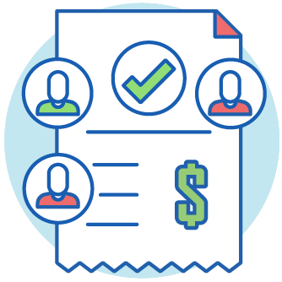

Best practice billing with SupportCenter Plus
Flexibly bill different customers based on the services delivered
Build personalized service plans for your accounts
Provide hassle-free, accurate billing
Bill rules
Create pre-paid and post-paid support plans | Bill cycles/period |
Base charges
Time entries | Contract billing

Slide 31

Ticket life cycle
Management

Slide 32
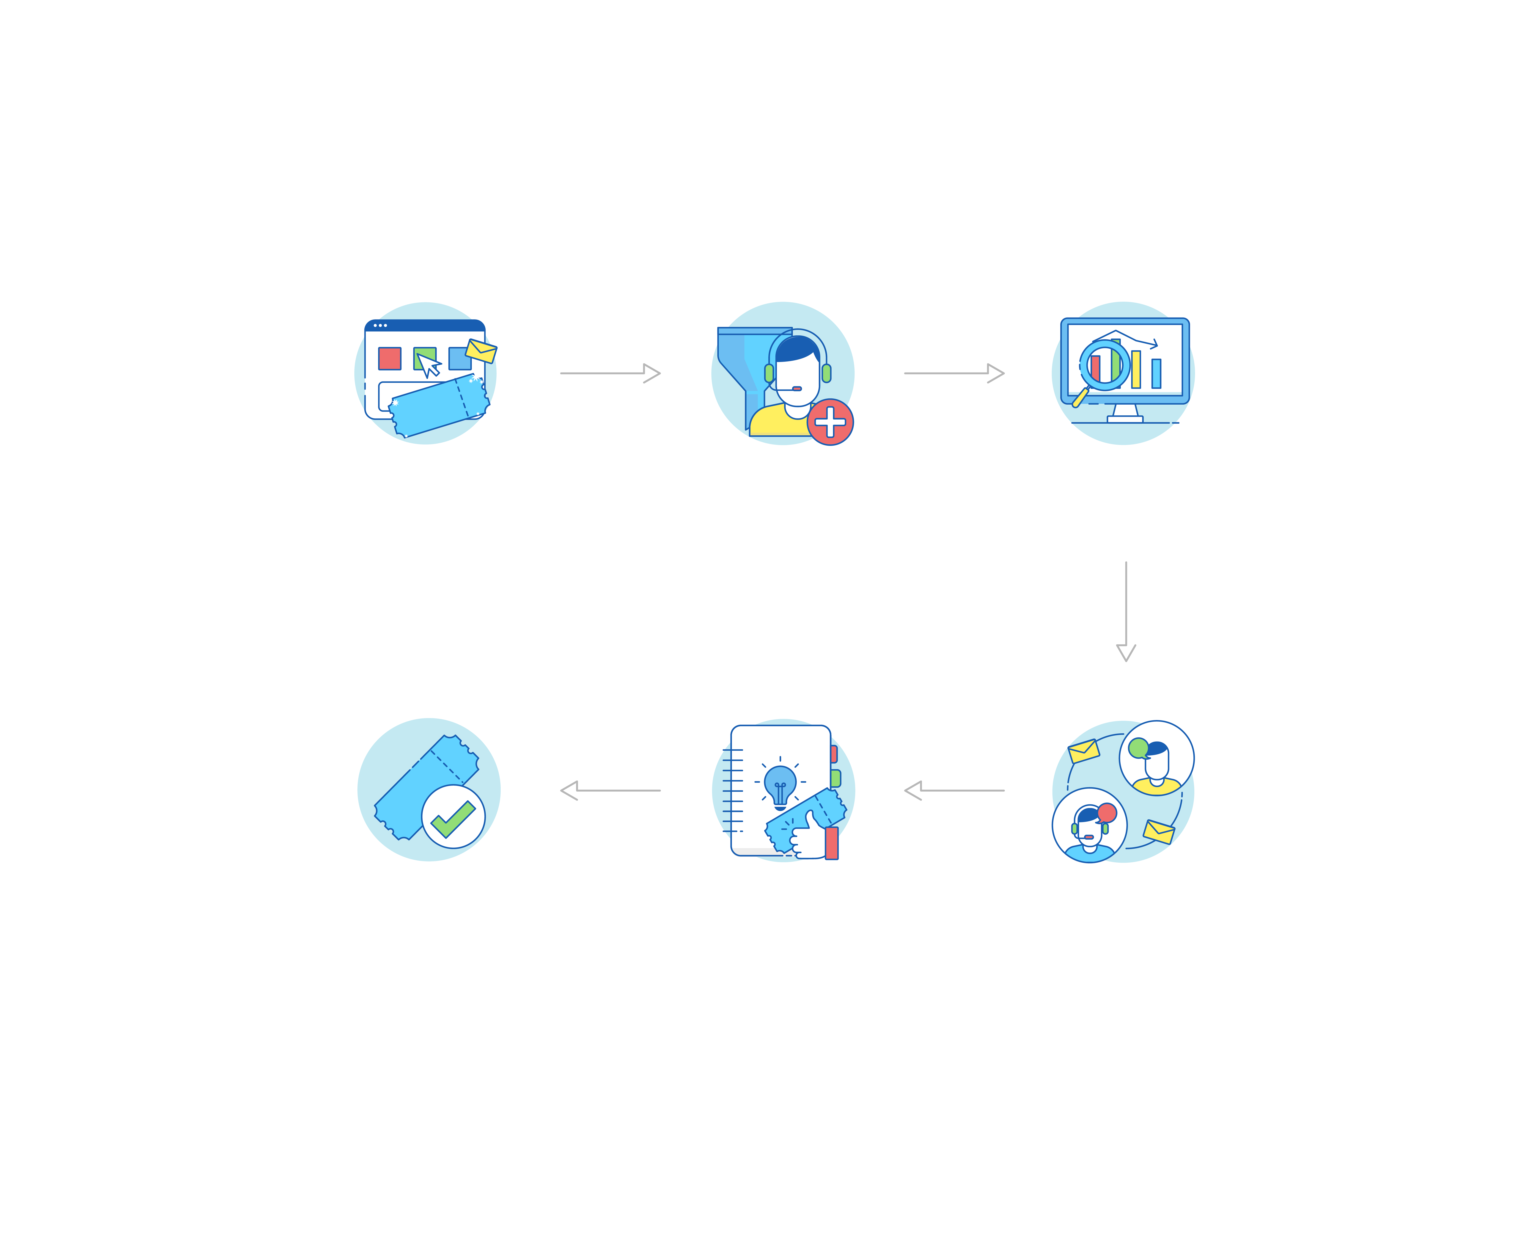
Ticket lifecycle
workflow
New support
ticket
Categorize,
prioritize, assign
Analysis
Remote desktop
Web portal, E-mail, Phone, Twitter, Custom forms & API
SLA, Contract,
Business Rule
Close ticket
Resolve ticket
Communicate with customer
Manual/Automated, User acknowledgment, Survey
Knowledge base
Email conversation within tickets, Canned responses

Slide 33
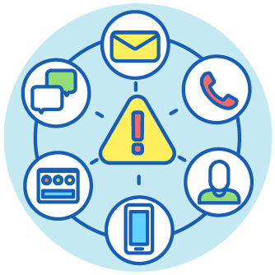
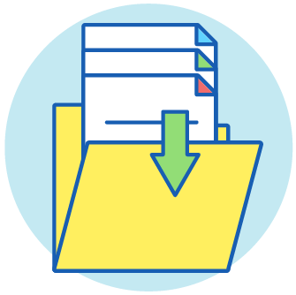
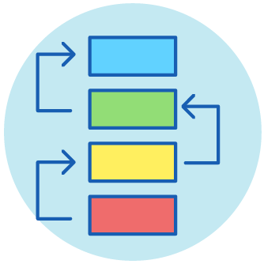
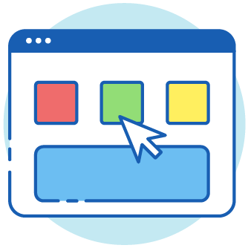
Best practice ticket lifecycle management
with SupportCenter Plus
Provide multiple channels for reporting issues
Collect comprehensive information on the issue during ticket logging
Multiple modes of ticket creation via email, phone, self-service portal, custom forms, and API
Customizable request templates
Perform automated categorization, prioritization, and assignment
Move to a shift-left model for L1 tickets
Self-service portal | Knowledge base
Business rules

Slide 34



Best practice ticket lifecycle management with SupportCenter Plus
Minimize resolution times
Communicate promptly to customers about ticket progress
Maximize customer satisfaction levels
Integrated knowledge base | Request sharing & collaboration
Notification rules | Canned responses | Notes
User surveys

Slide 35

Knowledge
Management

Slide 36
Knowledge management workflow
Create new KB articles
Organise under topics
Submit for approval
Publish in self-service portal
Text, Images, Attachments
Keywords for better visibility
Restrict to support reps or Publish to customers |
Allow ratings/comment by customers

Slide 37



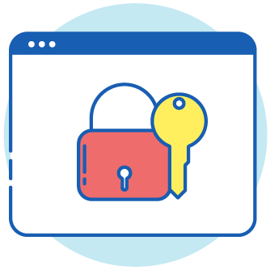

Best practice knowledge management
with SupportCenter Plus
Organize and structure the knowledge base
Have a review and approval process in place
Ensure transparency with authorship and version information
Topics and subtopics
| Keyword search
Solution review and approvals
| Solution expiration
Solution owner
| History
Define access permissions
Add solutions to the knowledge base from tickets
Support rep roles
Convert resolutions into knowledge base articles

Slide 38

Self-service
Portal

Slide 39
Self-service portal workflow
Configure and customize self-service portal
Publish kb articles in self-service portal
Customer raises new support ticket
Request management lifecycle
Close ticket
Customize the lay-out of the portal, authorize new users to access the portal with approval.
Suggest KB articles when a request is being logged | Offer various customized forms for ease of ticket creation

Slide 40



Self-service portal best practices
in SupportCenter Plus
Offer a personalized user experience
Preempt ticket creation by providing access to the knowledge base (KB)
Step up transparency with customers
Customize the layout of the portal for customers | Automate routine tasks including password resets
Share specific reports with customers in their portal | Export reports as PDF, HTML, CSV, XLS, and more.
Role-based user access | User groups

Slide 41

Reporting in
SupportCenter Plus

Slide 42
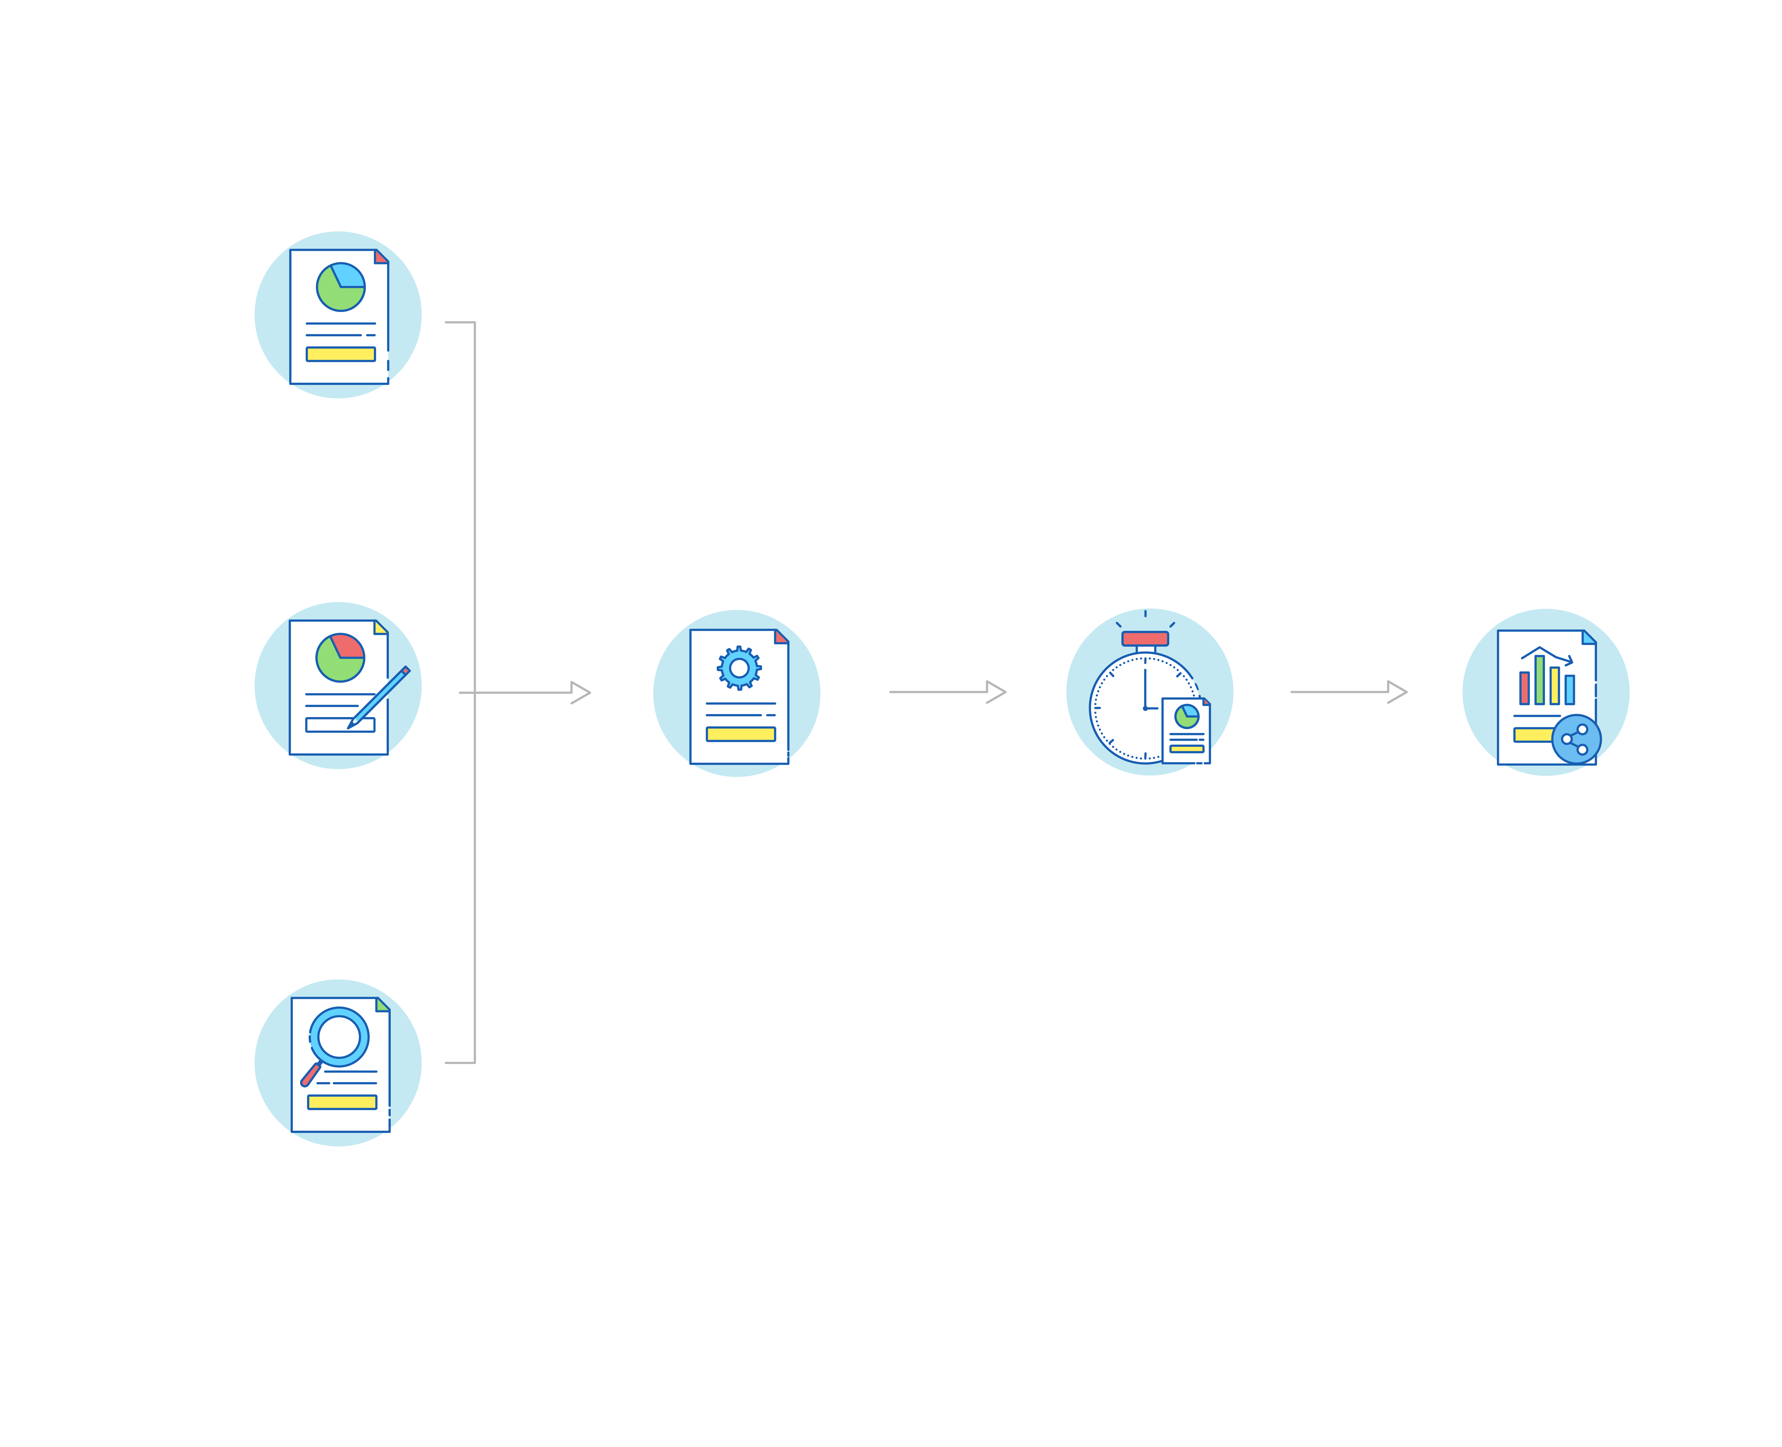
Reporting in SupportCenter Plus
Pre-defined
reports
Customizable
reports
Configure &
modify reports
Schedule
reports
Generate &
share reports
Report type, Choose desired data, Filter options,
Save reports
Email as HTML,XLS,CSV and PDF | Customize dashboard
Query
reports

Slide 43



Best practice reporting in SupportCenter Plus
Keep tabs on essential help desk metrics
Keep key stakeholders in the loop
Get a bird's-eye view on various business operations
Out-of-the-box reports | Custom dashboard widgets | Extract real-time information
Scheduled reports
| Email reports automatically
| Export reports as HTML, PDF, XLS, and CSV files
Compartmentalize reports for each portal

Slide 44

Integrations

Slide 45
Integrations in
SupportCenter Plus

Slide 46

Additional
capabilities

Slide 47




Advanced customization capabilities
in SupportCenter Plus
Create dynamic forms
Custom access privileges
Configure field and form rules to make your forms dynamic and contextual
Create custom support representative roles
Manage different products and services with ease.
Work in your language of choice
SupportCenter Plus is available in 37 different languages
Create and administer business units for different divisions in one place.

Slide 48

www.supportcenterplus.com
sales@manageengine.com

